Slide 1

LSTM(RNN) FOR TIME SERIES DATA
Asjadullah(120AD0027)
Sunil(120AD0010)

Slide 2

Table of content
RNN
VANISHING GRADIENT DESCENT
Long-Term Dependencies
SOLUTION OF RNN
LSTM
STANDARD RNN ARCHITECTURE
IDEA BEHIND LSTM
STEP-BY-STEP LSTM WALK THROUGH(ARCHITECTURE)
LSTM ARCITECTURE SUMMARY
CODE &IMPLEMENTATION

Slide 3
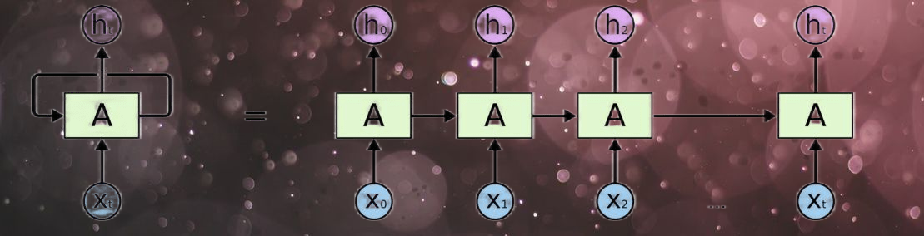
RNN
even though RNNs are quite powerful, they suffer from Vanishing gradient problem which hinders them from using long term information, like they are good for storing memory 3-4 instances of past iterations but larger number of instances don't provide good results so we don't just use regular RNNs. Instead, we use a better variation of RNNs: Long Short Term Networks(LSTM).

Slide 4
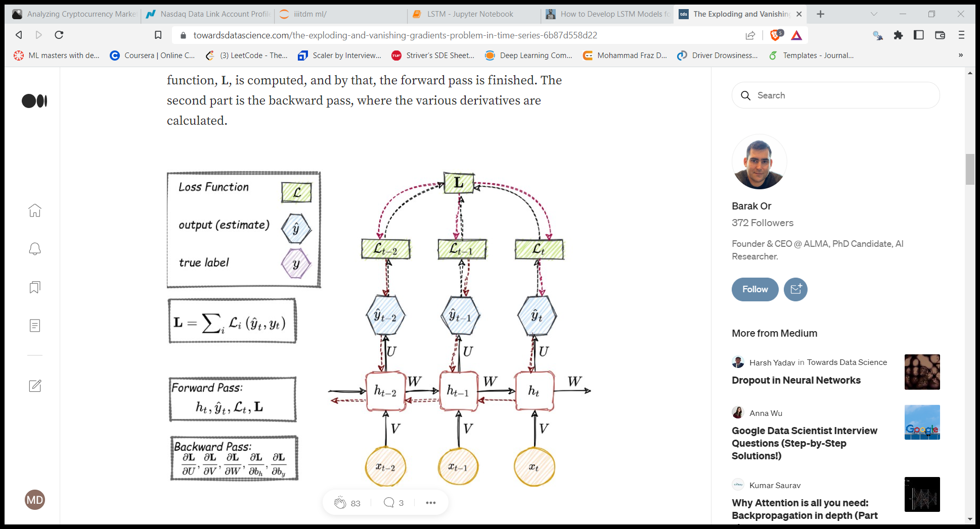
Backpropagation Through Time (BPTT)
Forward pass
Backward pass

Slide 5
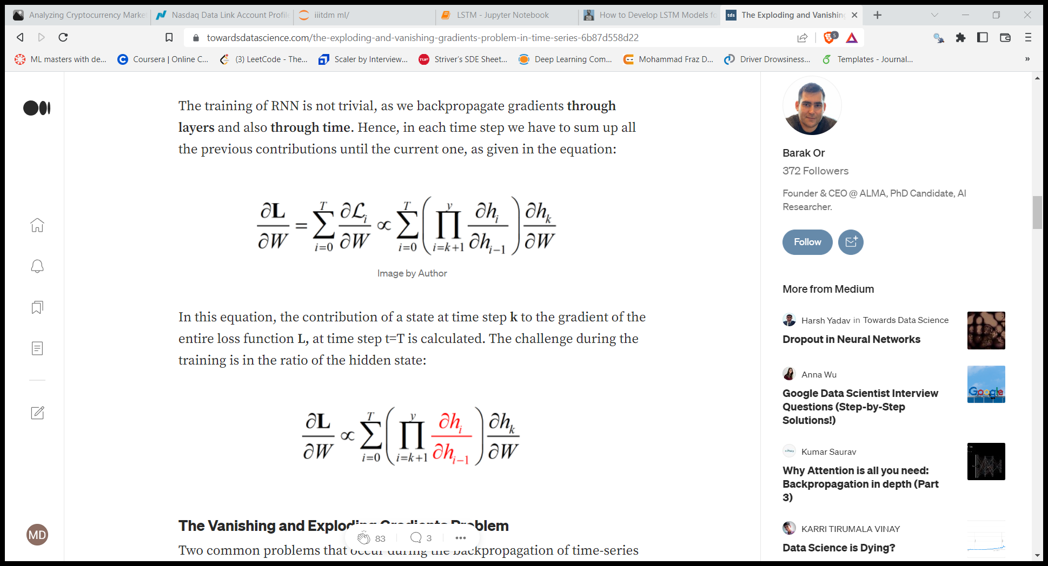
Backpropagation Through Time (BPTT)
The training of RNN is not trivial, as we backpropagate gradients through layers and also through time. Hence, in each time step we have to sum up all the previous contributions until the current one, as given in the equation:
Each of the neural network's weights receives an update proportional to the partial derivative of the error function with respect to the current weight in each iteration of training
the contribution of a state at time step k to the gradient of the entire loss function L, at time step t=T is calculated. The challenge during the training is in the ratio of the hidden state:

Slide 6
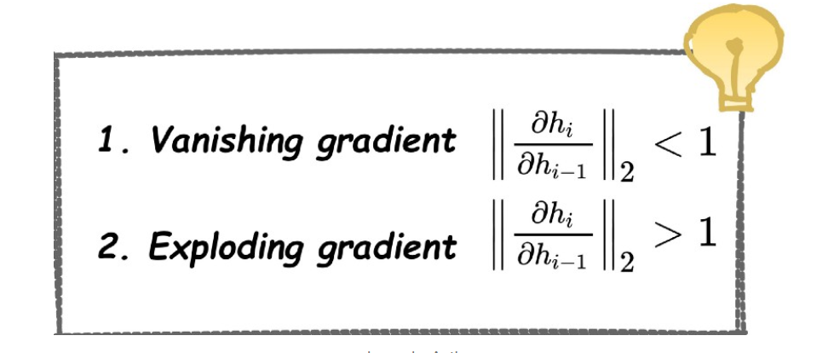
What is Vanishing Gradient problem?
Vanishing gradient problem is a difficulty found in training artificial neural networks with gradient-based learning methods and backpropagation.
As more layers using certain activation functions are added to neural networks, the gradients of the loss function approaches zero, making the network hard to train.

Slide 7
The Problem of Long-Term Dependencies
Sometimes, we only need to look at recent information to perform the present task. For example, consider a language model trying to predict the next word based on the previous ones. If we are trying to predict the last word in “the clouds are in the sky,” we don’t need any further context – it’s pretty obvious the next word is going to be sky. In such cases, where the gap between the relevant information and the place that it’s needed is small, RNNs can learn to use the past information.
But there are also cases where we need more context. Consider trying to predict the last word in the text “I grew up in France… I speak fluent French.” Recent information suggests that the next word is probably the name of a language, but if we want to narrow down which language, we need the context of France, from further back. It’s entirely possible for the gap between the relevant information and the point where it is needed to become very large.
Unfortunately, as that gap grows, RNNs become unable to learn to connect the information.

Slide 8
Solution
Initialize the weight matrix, W, with an orthogonal matrix, and use this through the entire training (multiplications of orthogonal matrices doesn’t explode or vanish).
have Long Short-Term Memory Networks (LSTMs).
Using ReLU activation function.

Slide 9
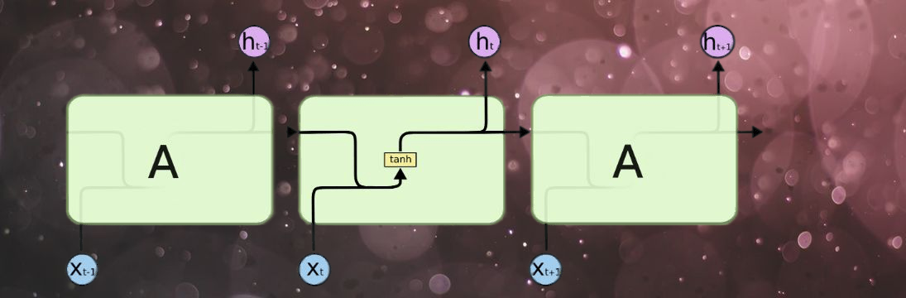
LSTM
standard RNN :
The hidden layer in the central block receives input xt from the input layer and also from itself in time point t-1, then it generates output ht and also another input for itself but in time point t+1.

Slide 10

The Core Idea Behind LSTMs
The LSTM does have the ability to remove or add information to the cell state, carefully regulated by structures called gates.
Gates are a way to optionally let information through. They are composed out of a sigmoid neural net layer and a pointwise multiplication operation.
The sigmoid layer outputs numbers between zero and one, describing how much of each component should be let through. A value of zero means “let nothing through,” while a value of one means “let everything through!”
An LSTM has three of these gates, to protect and control the cell state.

Slide 11
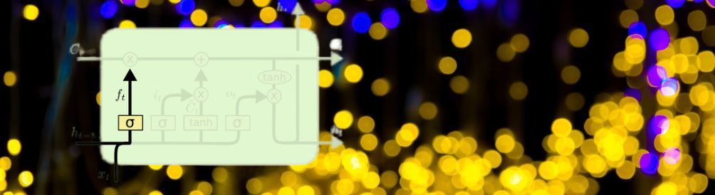
Step-by-Step LSTM Walk Through
The first step in our LSTM is to decide what information we’re going to throw away from the cell state. This decision is made by a sigmoid layer called the “forget gate layer.” It looks at ht−1 and xt, and outputs a number between 0 and 1 for each number in the cell state Ct−1. 1 represents “completely keep this” while a 0 represents “completely get rid of this.”
$$f_{t}=σ\left(w_{f}\left[h_{t−1},x_{t}\right]+b_{f}\right)$$

Slide 12
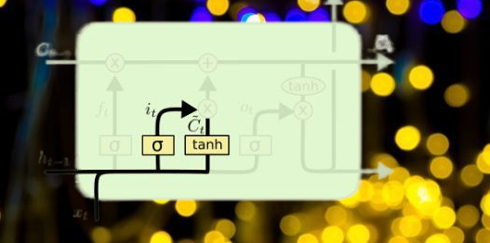
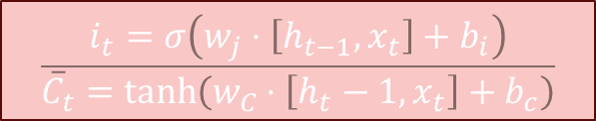
Step-by-Step LSTM Walk Through
The next step is to decide what new information we’re going to store in the cell state. This has two parts. First, a sigmoid layer called the “input gate layer” decides which values we’ll update. Next, a tanh layer creates a vector of new candidate values, C~t, that could be added to the state. In the next step, we’ll combine these two to create an update to the state.
$$\frac{i_{t}=σ\left(w_{j}⋅\left[h_{t−1},x_{t}\right]+b_{i}\right)}{{\overline{C}}_{t}=\tanh\left(w_{C}⋅\left[h_{t}−1,x_{t}\right]+b_{c}\right)}$$

Slide 13
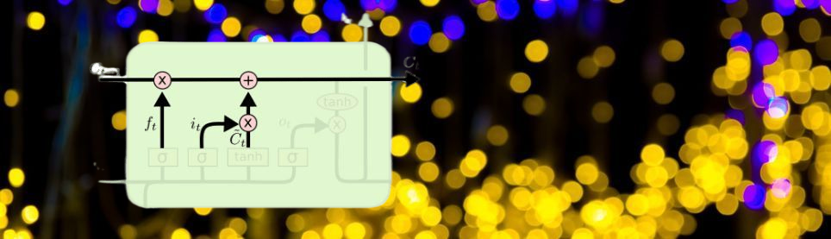
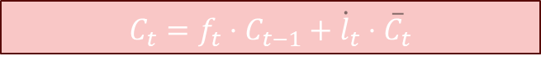
Step-by-Step LSTM Walk Through
It’s now time to update the old cell state, Ct−1, into the new cell state Ct. The previous steps already decided what to do, we just need to actually do it.We multiply the old state by ft, forgetting the things we decided to forget earlier. Then we add it∗C~t. This is the new candidate values, scaled by how much we decided to update each state value.
$$C_{t}=f_{t}⋅C_{t−1}+{\dot{l}}_{t}⋅{\overline{C}}_{t}$$

Slide 14
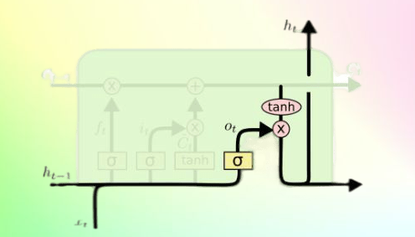
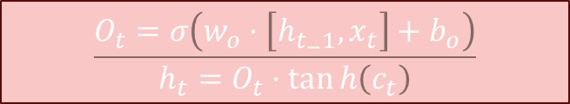
Step-by-Step LSTM Walk Through
Finally, we need to decide what we’re going to output. This output will be based on our cell state, but will be a filtered version. First, we run a sigmoid layer which decides what parts of the cell state we’re going to output. Then, we put the cell state through tanh (to push the values to be between −1 and 1) and multiply it by the output of the sigmoid gate, so that we only output the parts we decided to.
$$\frac{O_{t}=σ\left(w_{o}⋅\left[h_{t_{−}1},x_{t}\right]+b_{o}\right)}{h_{t}=O_{t}⋅\tan{h\left(c_{t}\right)}}$$

Slide 15
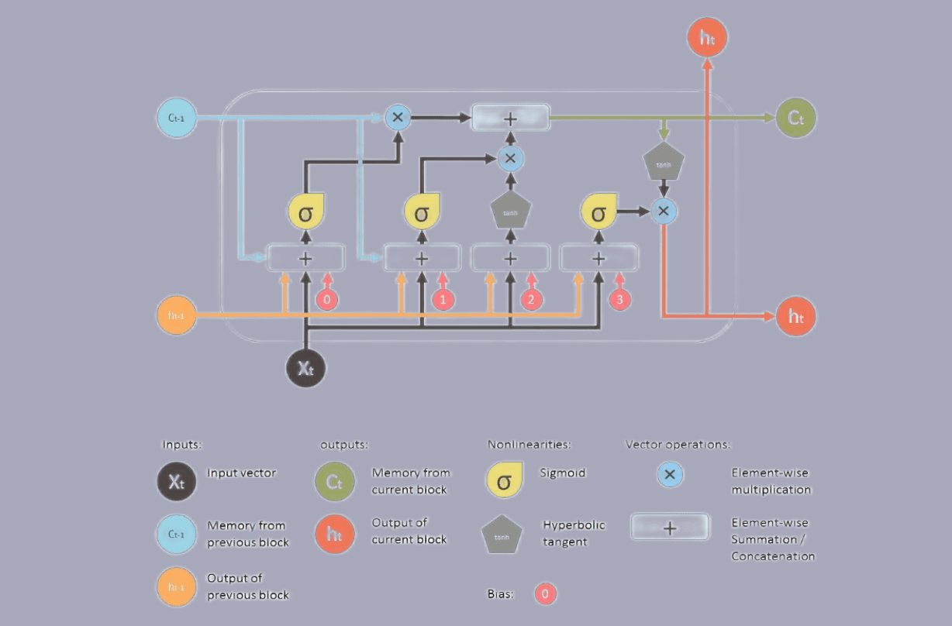
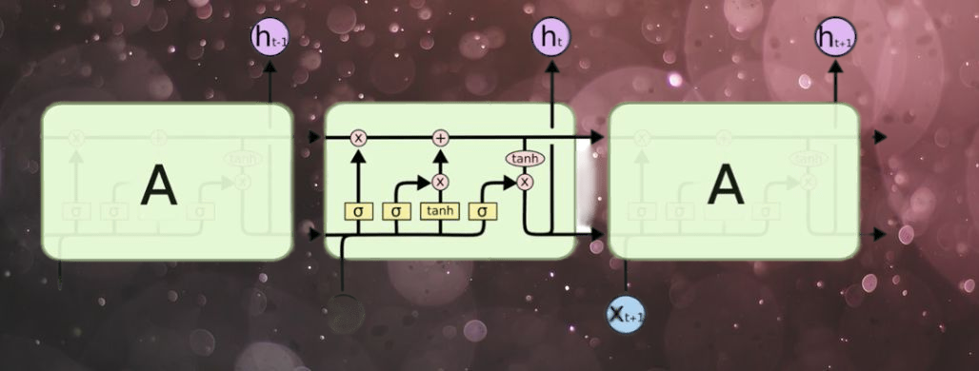
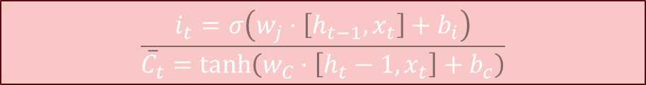

LSTM SUMMARY
$$\frac{O_{t}=σ\left(w_{o}⋅\left[h_{t_{−}1},x_{t}\right]+b_{o}\right)}{\begin{aligned}h_{t}=O_{t}⋅\tan{h\left(c_{t}\right)} \\ \end{aligned}}$$
$$f_{t}=σ\left(w_{f}\left[h_{t−1},x_{t}\right]+b_{f}\right)$$
$$\frac{i_{t}=σ\left(w_{j}⋅\left[h_{t−1},x_{t}\right]+b_{i}\right)}{{\overline{C}}_{t}=\tanh\left(w_{C}⋅\left[h_{t}−1,x_{t}\right]+b_{c}\right)}$$
$$C_{t}=f_{t}⋅C_{t−1}+{\dot{l}}_{t}⋅{\overline{C}}_{t}$$

Slide 16
Code & Implementation
Univariate LSTM Models
Vanilla LSTM
Stacked LSTM
Bidirectional LSTM
CNN LSTM
ConvLSTM
Multivariate LSTM Models
Multiple Input Series.
Multiple Parallel Series.
Multi-Step LSTM Models
Vector Output Model
Encoder-Decoder Model
Multivariate Multi-Step LSTM Models
Multiple Input Multi-Step Output.
Multiple Parallel Input and Multi-Step Output.

Slide 17
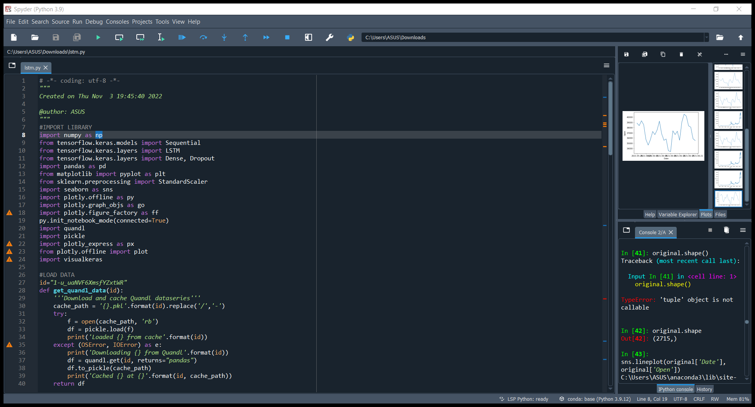
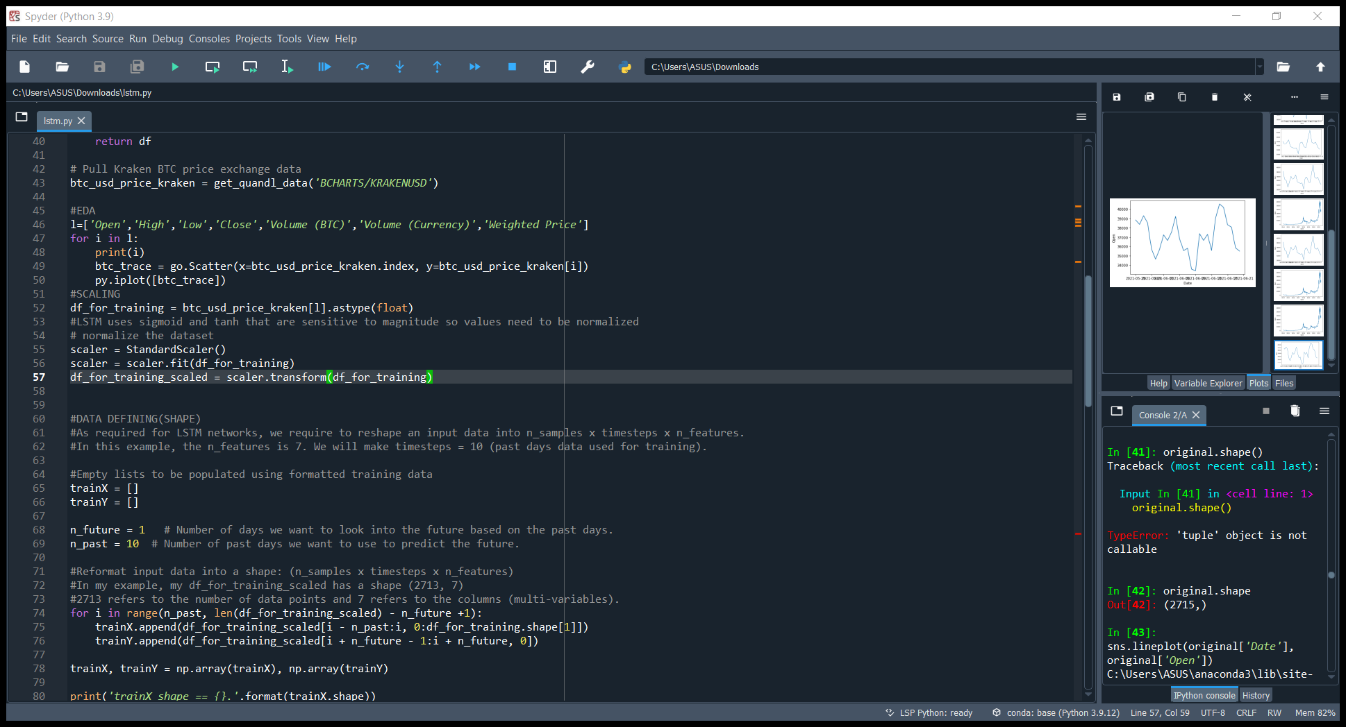
BITCOIN STOCK FORCASTING

Slide 18
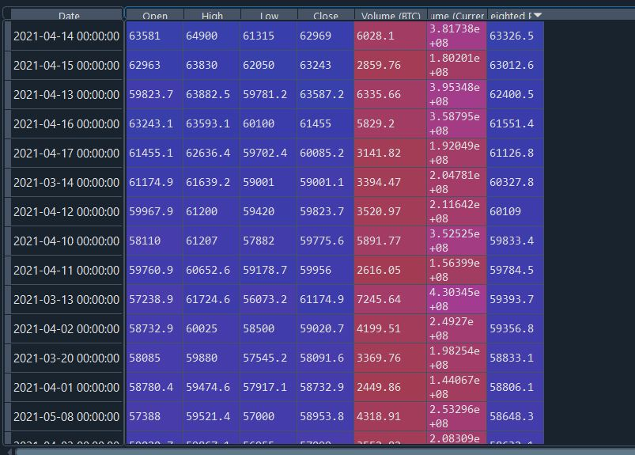
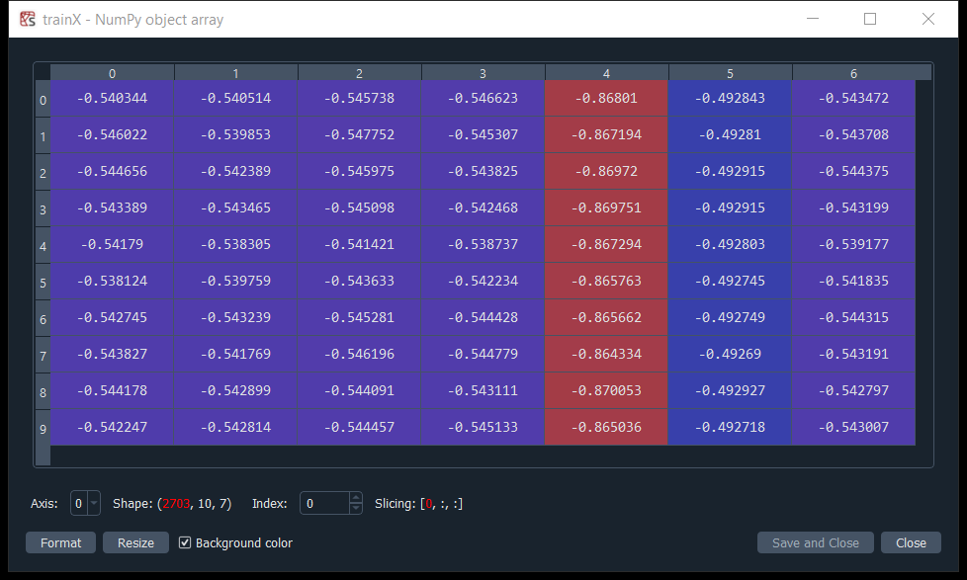
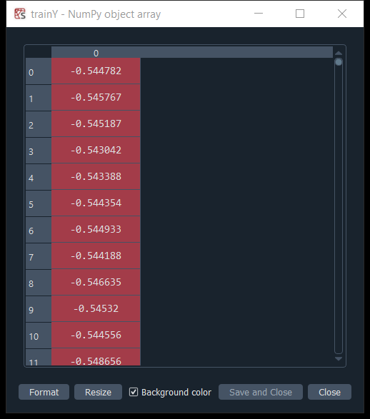
DATA PREPROCESSING

Slide 19
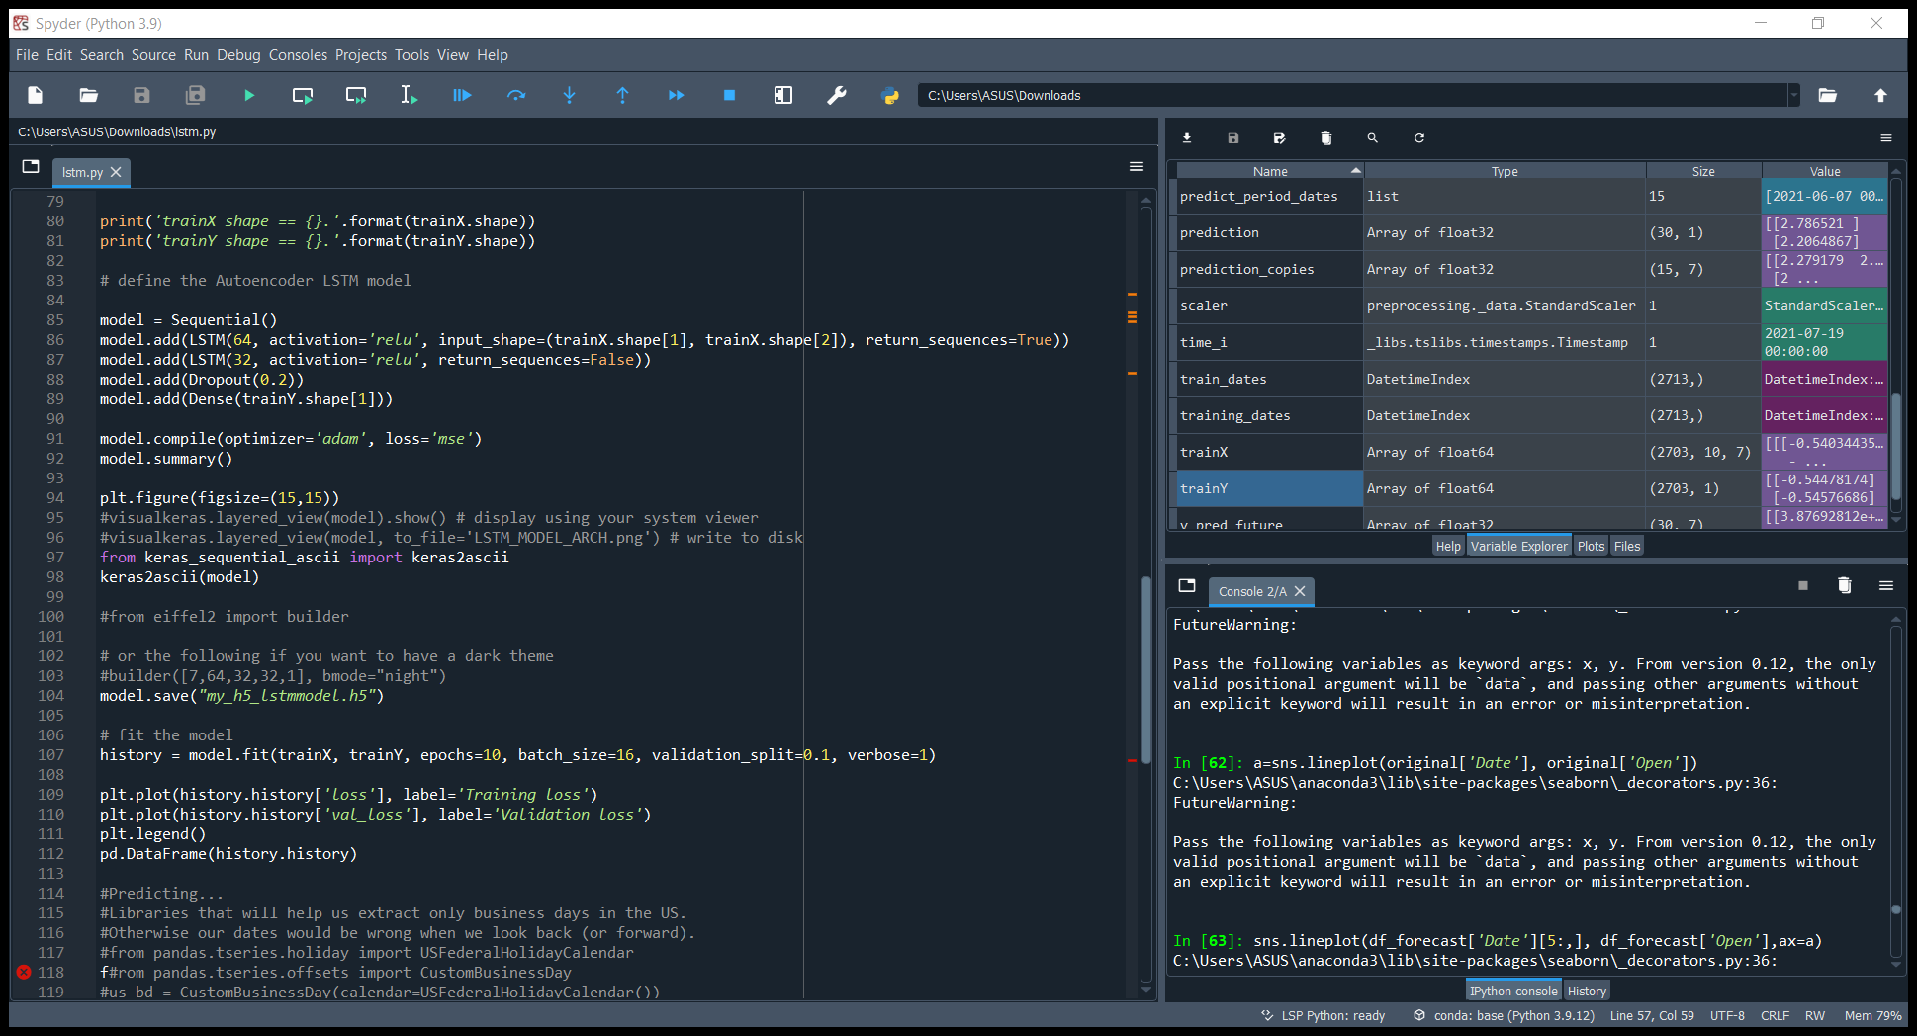
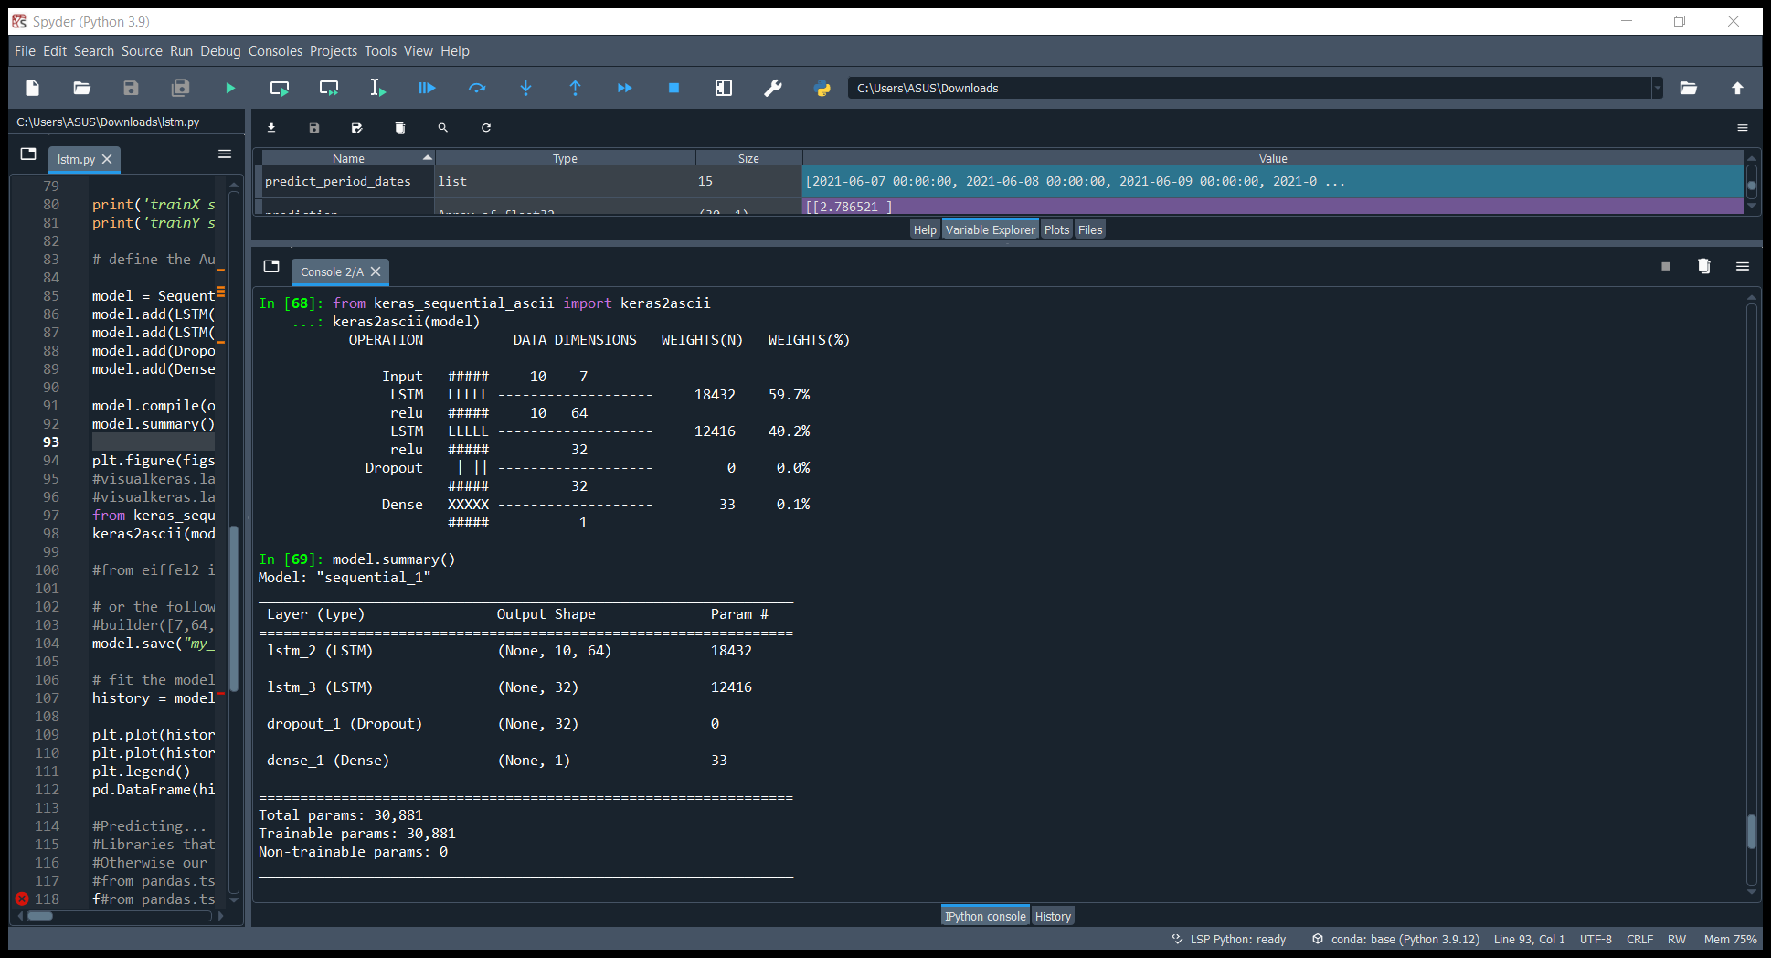
MODEL BUILDING

Slide 20
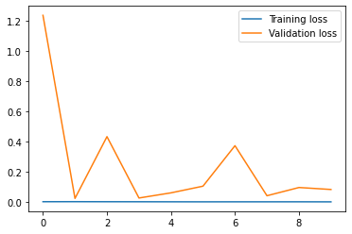
TRAINING

Slide 21
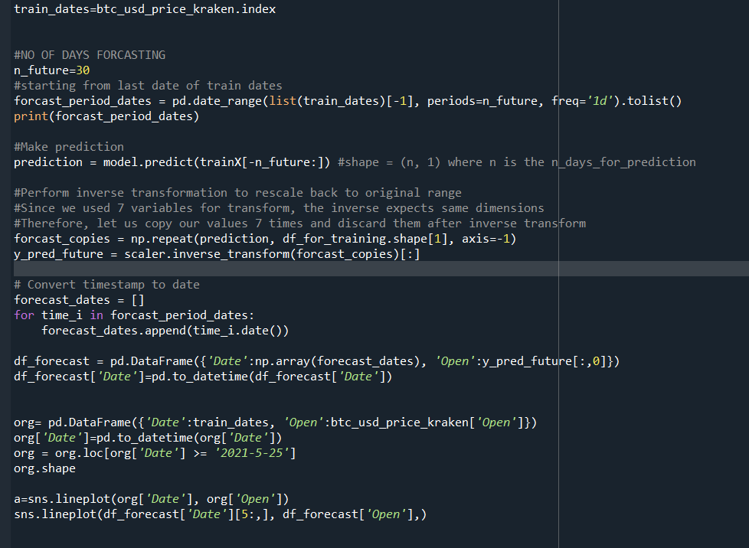
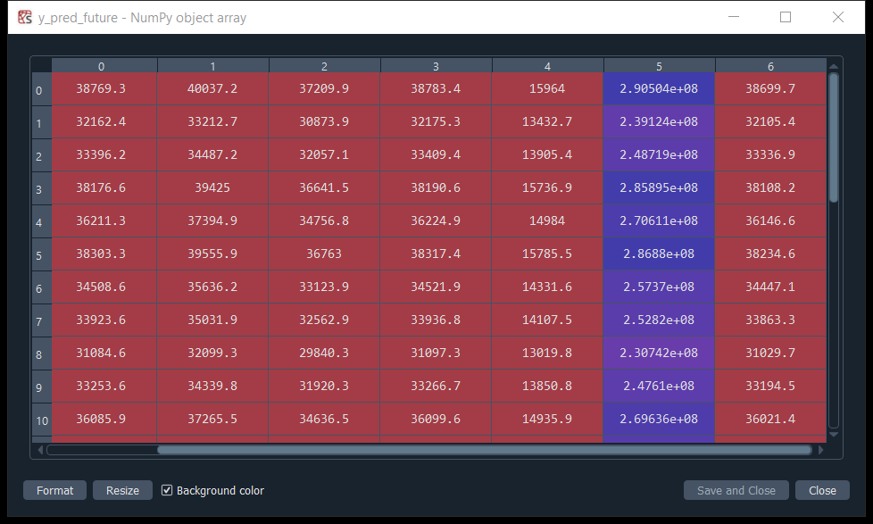
FORCASTING

Slide 22
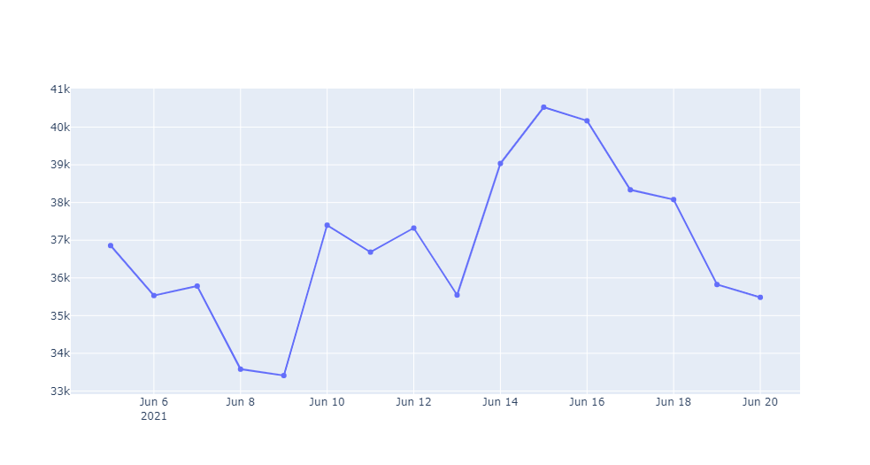
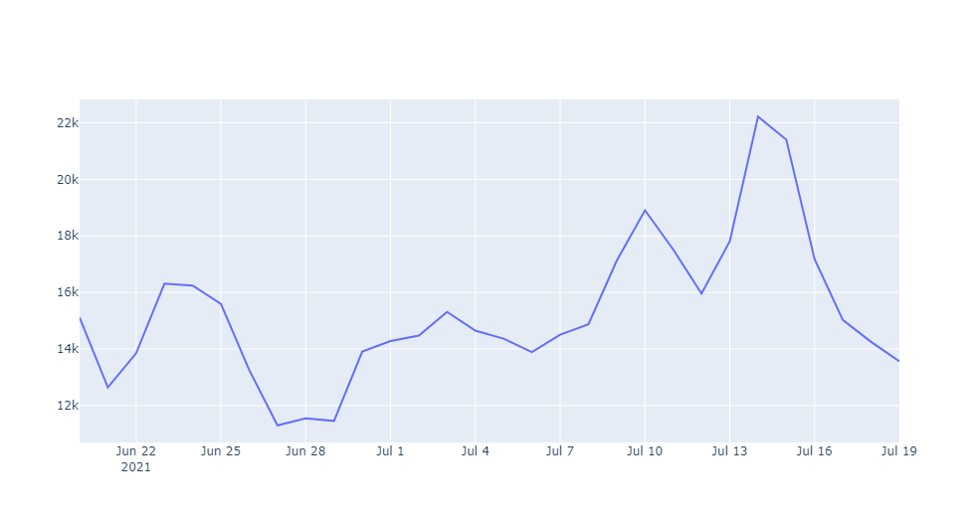
RESULT

Slide 23
THANK YOU

